Slide 1
Navigation and Routing Basics

Slide 3

Module Overview
How does routing work?
Configuring routes Tying routes to actions Placing the views

Slide 4
Application Architecture
Welcome Component
index.html
App Component
Product List Component
Star Component
Product Detail Component
Product Data Service

Slide 5
Application Architecture
Welcome Component
index.html
App Component
Product List Component
Star Component
Product Detail Component
Product Data Service

Slide 6
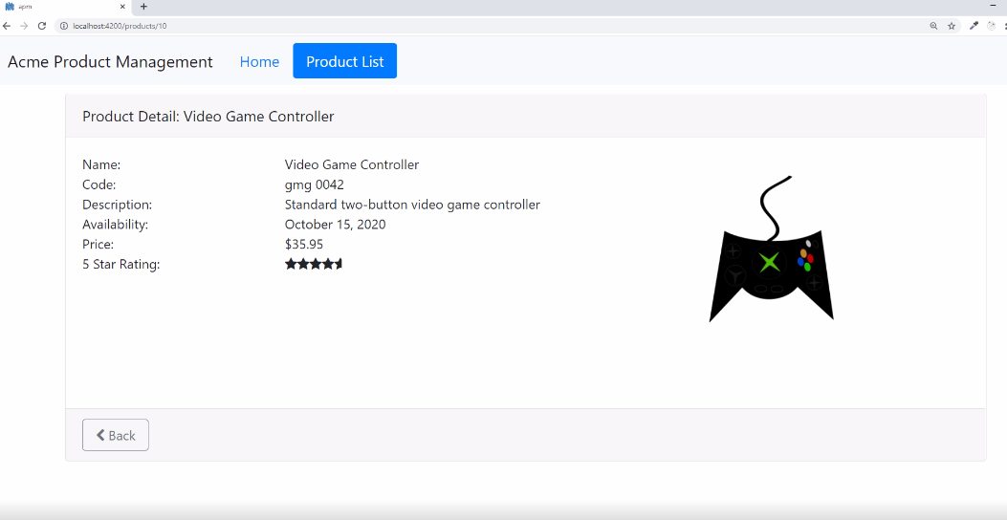

Slide 7
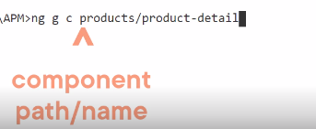
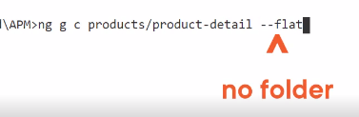

Slide 8
AppModule
BrowserModule |  | FormsModule |  | HttpClientModule
AppComponent
Produ Comp | ctList - onent
ConvertT Pi | oSpaces - pe
StarComponent
Imports Exports Declarations Bootstrap

Slide 9
AppModule
BrowserModule |  | FormsModule |  | HttpClientModule
AppComponent
Produ Comp | ctList - onent
ConvertT Pi | oSpaces - pe
StarComponent
ProductDetail - Component
WelcomeComponent
Imports Exports Declarations Bootstrap

Slide 10
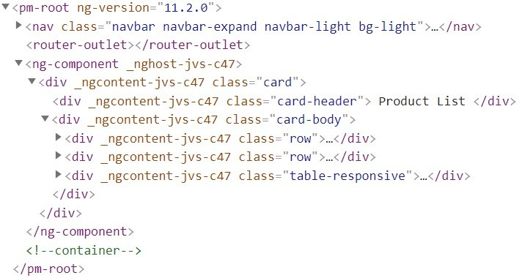
How Routing Works
Configure a route for each component
Define options/actions
Tie a route to each option/action Activate the route based on user action
Activating a route displays the component's view

Slide 11
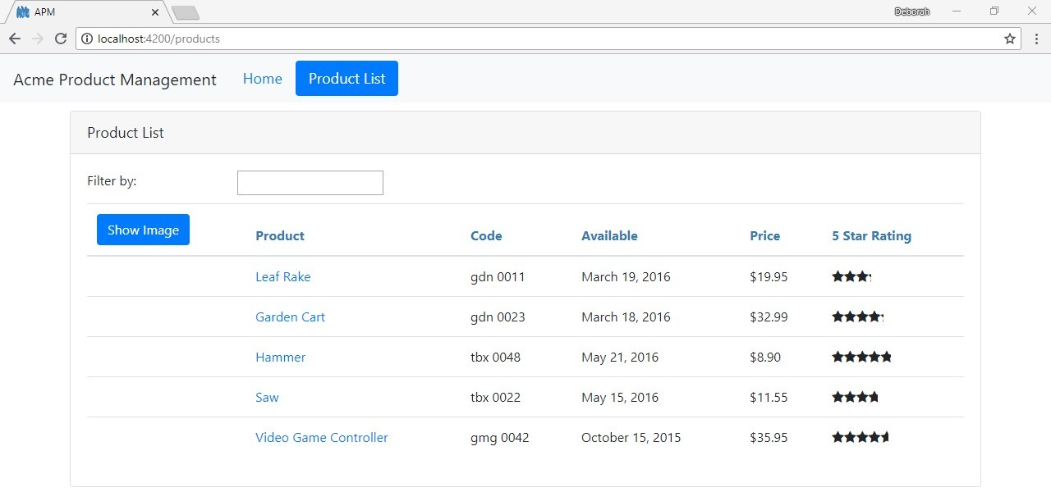
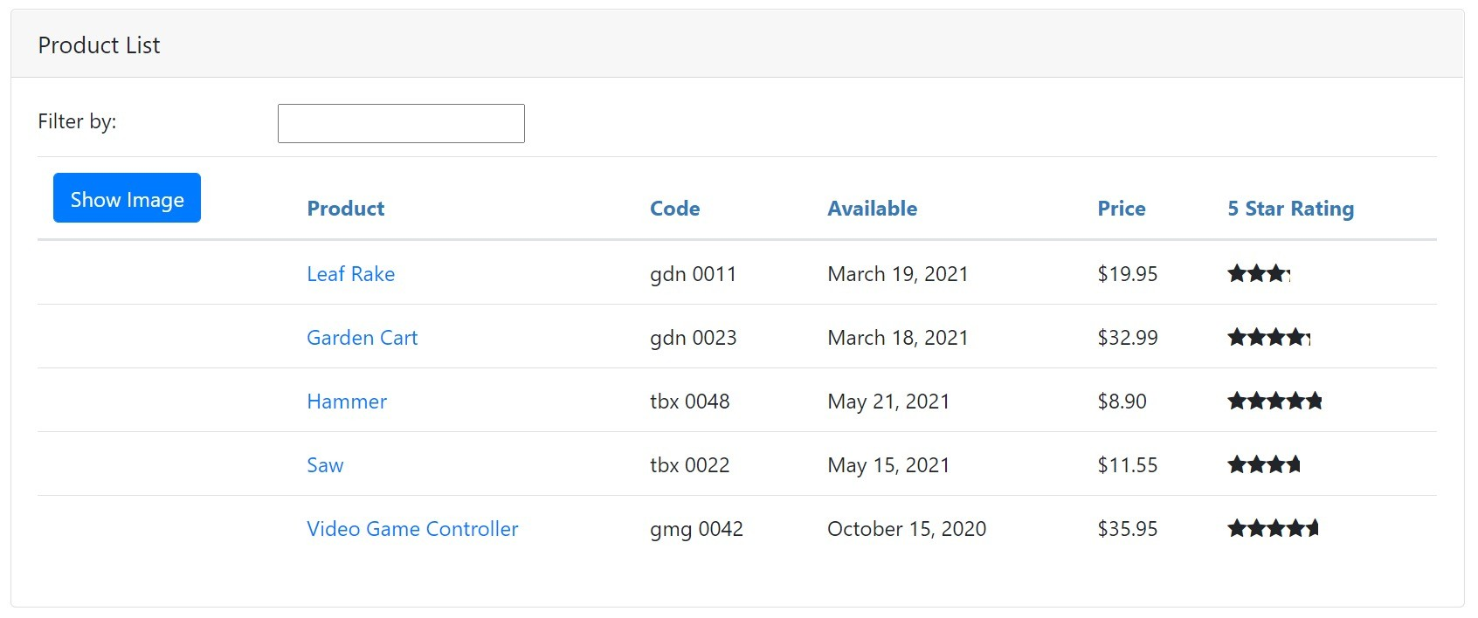
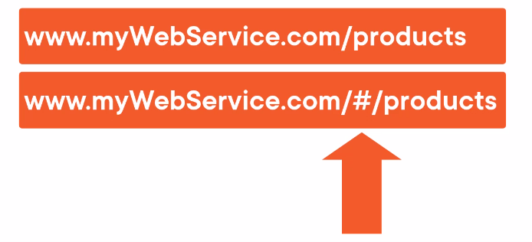
How Routing Works
<a routerLink="/products">Product List</a>
{ path: 'products', component: ProductListComponent }
product-list.component.ts
<router-outlet></router-outlet>
import { Component } from '@angular/core';
@Component({
templateUrl: './product-list.component.html'
})
export class ProductListComponent { }

Slide 12
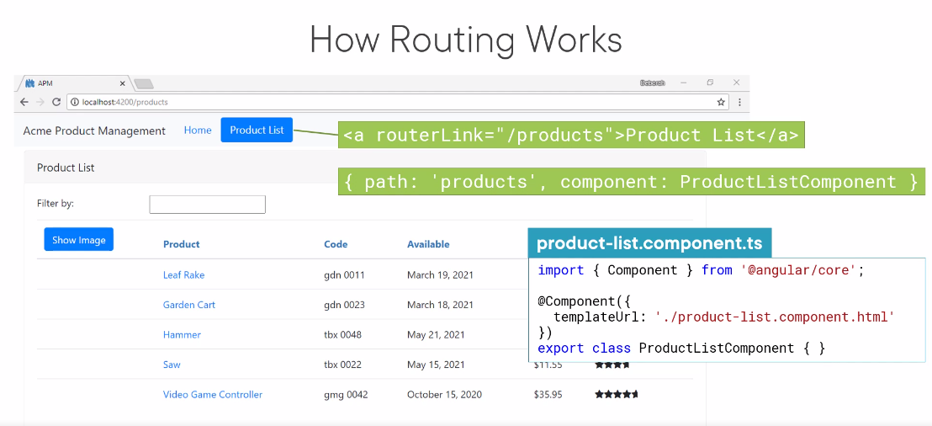

Slide 13
'products', ProductListComponent
'products/:id', ProductDetailComponent
'welcome', WelcomeComponent

Slide 14
Configuring Routes
app.module.ts
...
import { RouterModule } from '@angular/router';
@NgModule({ imports: [
BrowserModule, FormsModule, HttpClientModule, RouterModule
],
declarations: [
...
],
bootstrap: [ AppComponent ]
})
export class AppModule { }

Slide 15
Configuring Routes
app.module.ts
...
import { RouterModule } from '@angular/router';
@NgModule({ imports: [
BrowserModule, FormsModule, HttpClientModule, RouterModule.forRoot([])
],
declarations: [
...
],
bootstrap: [ AppComponent ]
})
export class AppModule { }

Slide 16
Configuring Routes
[
{ | path: | 'products', component: ProductListComponent },
{ | path: | 'products/:id', component: ProductDetailComponent },
{ | path: | 'welcome', component: WelcomeComponent },
{ path: '', redirectTo: 'welcome', pathMatch: 'full' },
{ path: '**', component: PageNotFoundComponent }
]

Slide 17

Demo
Configuring routes

Slide 18

Navigating the Application Routes
Menu option, link, image or button that activates a route
Typing the Url in the address bar / bookmark The browser's forward or back buttons

Slide 19
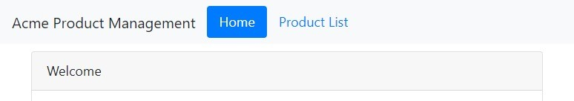
Tying Routes to Actions

Slide 20

Tying Routes to Actions
app.component.ts
@Component({
selector: 'pm-root', template: `
<ul class='nav navbar-nav'>
<li><a>Home</a></li>
<li><a>Product List</a></li>
</ul>
`
})

Slide 21
Tying Routes to Actions
app.component.ts
@Component({
selector: 'pm-root', template: `
<ul class='nav navbar-nav'>
<li><a [routerLink]="['/welcome']">Home</a></li>
<li><a [routerLink]="['/products']">Product List</a></li>
</ul>
`
})
<li><a routerLink="/welcome">Home</a></li>
<li><a routerLink="/products">Product List</a></li>

Slide 22
Placing the Views
app.component.ts
@Component({
selector: 'pm-root', template: `
<ul class='nav navbar-nav'>
<li><a [routerLink]="['/welcome']">Home</a></li>
<li><a [routerLink]="['/products']">Product List</a></li>
</ul>
<router-outlet></router-outlet>
`
})

Slide 23
How Routing Works
<a routerLink="/products">Product List</a>
{ path: 'products', component: ProductListComponent }
product-list.component.ts
import { Component } from '@angular/core';
<router-outlet></router-outlet>
@Component({
templateUrl: './product-list.component.html'
})
export class ProductListComponent { }

Slide 24
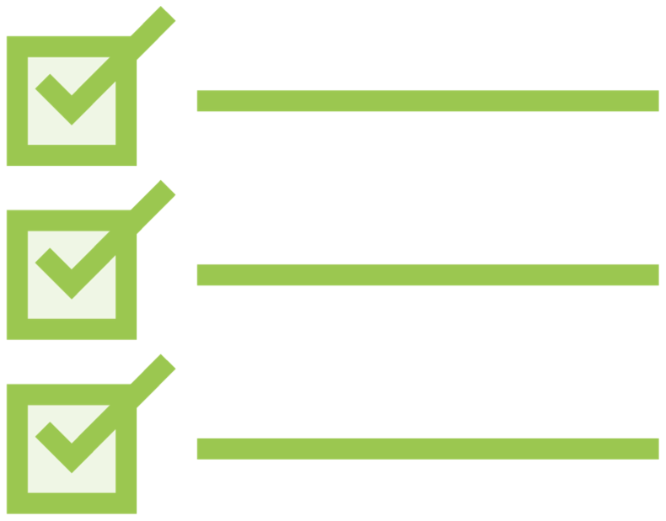
Routing Checklist: Displaying Components
Nest-able components
- Define a selector
@Component({
selector: 'pm-products',
templateUrl: './product-list.component.html'
})
- Nest in another component
<div><h1>{{pageTitle}}</h1>
<pm-products></pm-products>
</div>
No route
Routed components
No selector or nesting
Configure routes
[
{ path: 'products', component: ProductListComponent }
]
- Tie routes to actions

Slide 25
Routing Checklist: Doing Routing
Configure routes
Tie routes to actions Place the view

Slide 26
Routing Checklist: Configuring Routes
Define the base element
<head>
...
<base href="/">
</head>
Add RouterModule
@NgModule({ imports: [ ...,
RouterModule.forRoot([])
],
declarations: [...], bootstrap: [ AppComponent ]
})
export class AppModule { }

Slide 27
Routing Checklist: Configuring Routes
Add each route to forRoot array
Order matters
path: Url segment for the route
No leading slash
'' for default route
'**' for wildcard route
component
Not string name; not enclosed in quotes
RouterModule.forRoot([
{ path: 'products', component: ProductListComponent }, …
{ path: '', redirectTo: 'welcome', pathMatch: 'full' },
{ path: '**', redirectTo: 'welcome', pathMatch: 'full' }
])

Slide 28
Routing Checklist:
Tying Routes to Actions
Add the RouterLink directive as an attribute
Clickable element
Enclose in square brackets
Bind to a link parameters array
First element is the path
All other elements are route parameters
<ul>
<li><a [routerLink]="['/welcome']">Home</a></li>
<li><a [routerLink]="['/products']">Product List</a><
/li>
</ul>

Slide 29
Routing Checklist: Placing the View
Add the RouterOutlet directive
Identifies where to display the routed component's view
Specified in the host component's template
<ul>
<li><a [routerLink]="['/welcome']">Home</a></li>
<li><a [routerLink]="['/products']">Product List</a><
/li>
</ul>
<router-outlet></router-outlet>

Slide 30
Application Architecture
Welcome Component
index.html
App Component
Product List Component
Star Component
Product Detail Component
Product Data Service

Slide 31
Application Architecture
Welcome Component
index.html
App Component
Product List Component
Star Component
Product Detail Component
Product Data Service

Slide 32

Coming up next …
Navigation and Routing Additional Techniques

